Slide 1
Group Project 2B: Predator-Prey Model
Lingfei Zhao, Yuan Ji, Melissa Wu

Slide 2
Introduction
Wrote a program that simulated a 2D predator-prey model
Parameters:
Initial number of fish
Initial number of sharks
Number of timesteps for fish to procreate
Number of timesteps for shark to procreate
Number of timesteps for shark to starve to death

Slide 3
In class algorithm
Five grids:
Fish: presence or absence of fish. -1 for no fish, otherwise age of fish
Shark: presence or absence of shark
Fishmove: hold a record whether fish has already been moved in current timestep
Sharkmove: same for shark
Sharkstarve: stores time when shark has last eaten

Slide 4
Our algorithm
Two directories
Age of the fish at every position (holds age and position)
Age of the shark and time since last meal at every position (holds age and position)
One grid
Presence or absence of fish or shark (1 for fish, -1 for shark, 0 for nothing) at every position

Slide 5
Our algorithm
Update fish directory first, then update shark directory
If fish or shark change position, update grid

Slide 6
Initial parameters
To achieve quasi-periodic state:
40 x 40 grid
300 initial fish
20 initial shark
10 step breeding age for fish
20 step breeding age for shark
10 step starvation time for shark

Slide 7
Initial parameters
15:1 ratio of fish:shark
1:2 ratio of breeding age for fish:shark
Otherwise, species might go to extinction

Slide 8
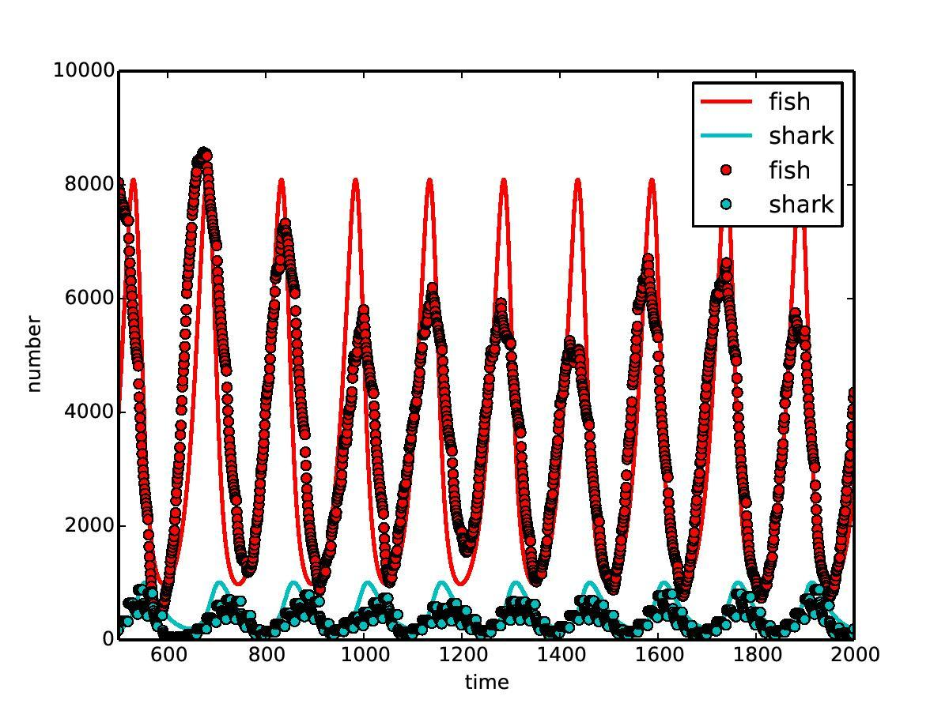
Fish amplitude is not constant
Shark plot is phase-shifted a little from fish plot, as expected

Slide 9
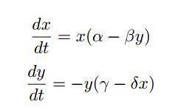
Lotka-Vdterra equations
Setting both to zero gives
x as a min/max when
y = α / β
y as a min/max when
x = γ / ẟ

Slide 10
Lotka-Vdterra equations
We can use observed minimum and maximum values for fish and shark, respectively, to calculate corresponding parameters needed in Lotka-Vdterra equations with a bit of algebra (not shown)
Let x_{min} and x_{max} be the minimum and maximum values for fish population plot, respectively
Same for y_{min} and y_{max} for shark population plot

Slide 11
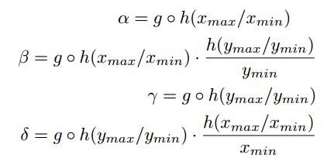


Lotka-Vdterra equations
Where

Slide 12
Video
Here

